Slide 1
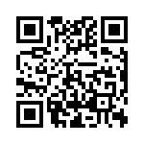


Welcome to Webinar Wednesday
Today’s Topic: instaGrok
bit.ly/instaGrokWebinar
https://goo.gl/9c4acX

Slide 2

What is instaGrok?
instaGroK finds educational websites, videos, and images on any topic.
instaGrok’s interactive interface helps students understand key concepts, facts, and relationships.
Quizzes help students review what they have learned.

Slide 3
Why instaGrok?
Platform > Google Search
Visual Representation
Dynamic Results
GREAT

Slide 4
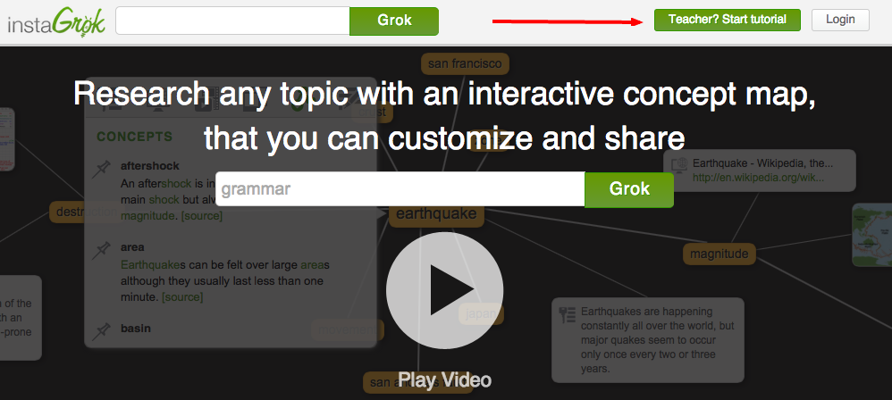
Getting Started with instaGrok . . .
www.instagrok.com
start the tutorial
1
2

Slide 5
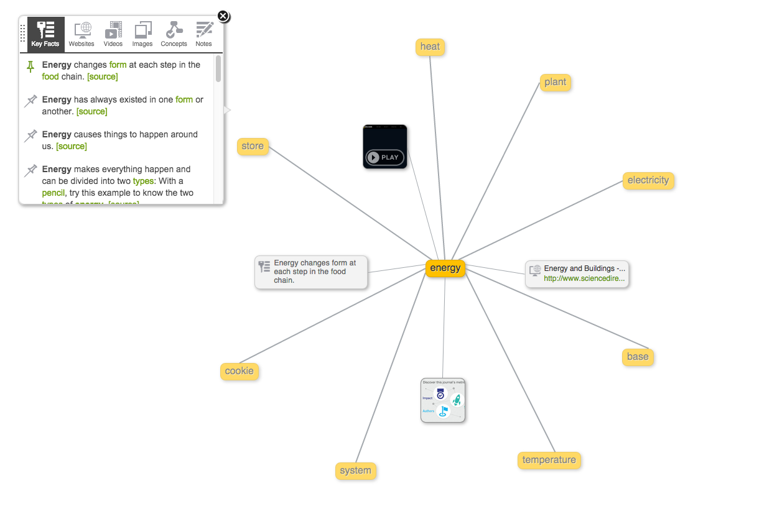
Explore
Type in a concept to explore and select “grok” (search)
This is called a “grok.”
key facts
websites
videos
images
concepts (pins)
notes

Slide 6
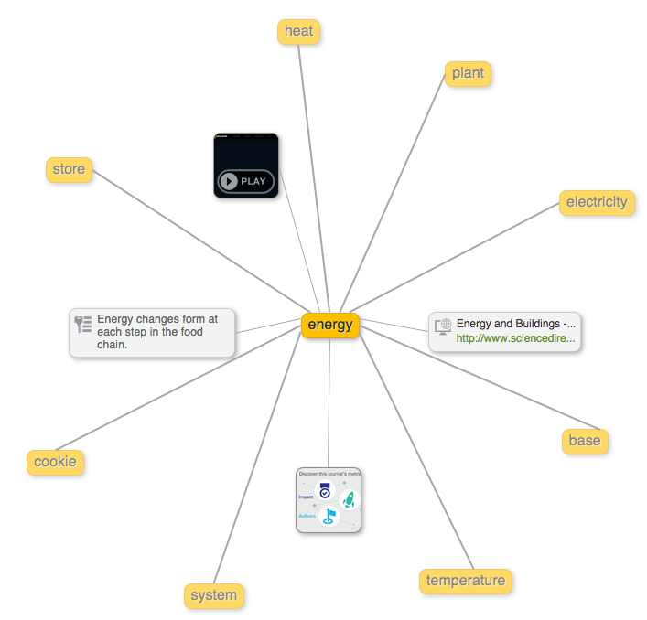
My concept map
I chose to “grok” energy.
Site
Video
Journal

Slide 7

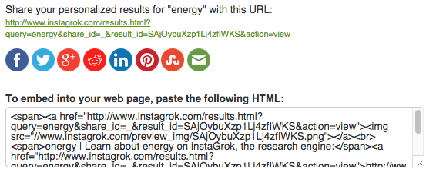
instaGrok options
Adjustable
Sharing options

Slide 8
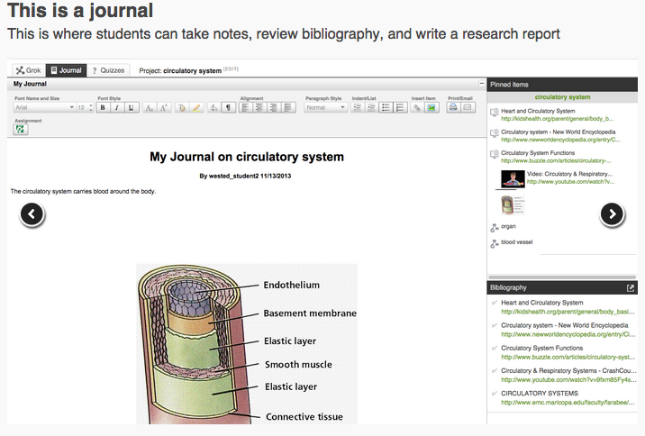
instaGrok features . . . journal
pinned items
are stored
here for ease
of access during journaling
Bibliography
feature is
awesome!

Slide 9
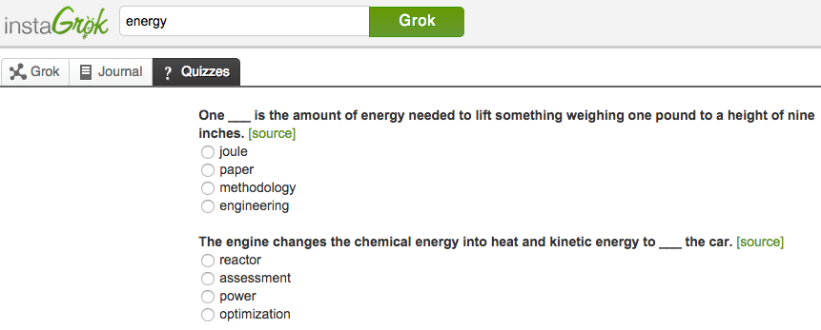
Quizzes
multiple choice standard 4 options
sources available
for student research

Slide 10
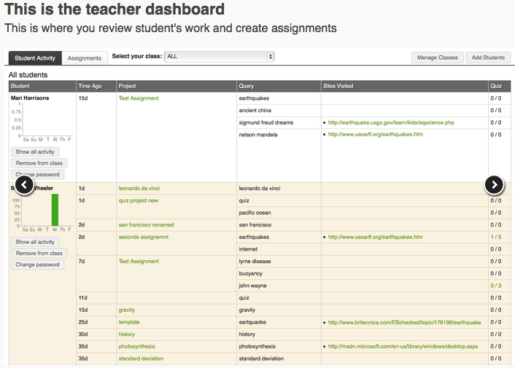
Teacher Dashboard
only available if you sign up for a teacher account

Slide 11
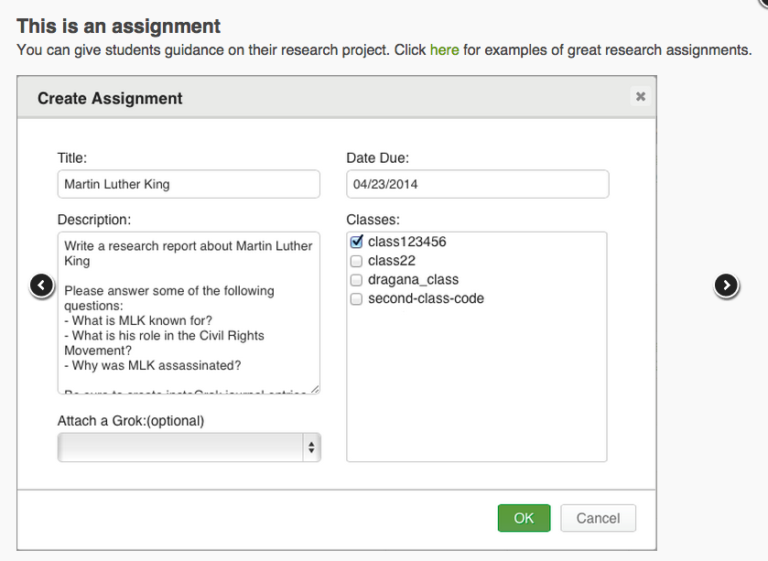
Create an Assignment
Example Assignments
Available
Add a Grok for support
Assignment
Options

Slide 12
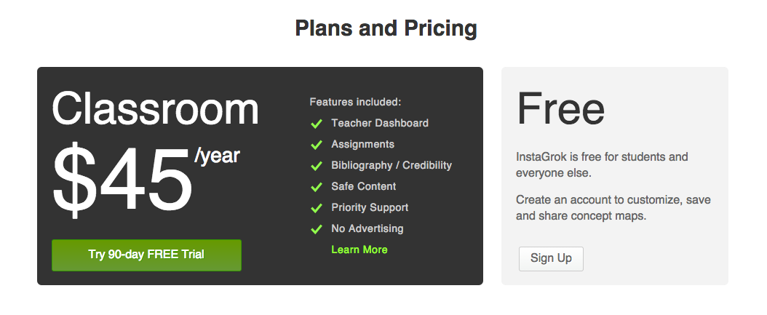
Is there a catch?
Teacher Dashboard
Decisions…Decisions

Slide 13
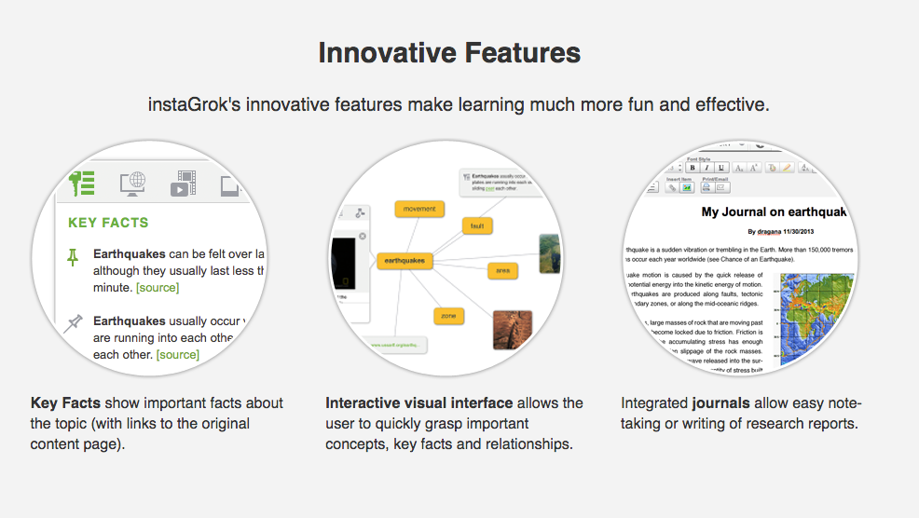
Three Cheers for instaGrok !!!

Slide 14
Thank you for attending today’s webinar!
bit.ly/instaGrokWebinar

